Slide 1
Intelligent Indexing: A Semi-Automated, Trainable System for Field Labeling
Robert Clawson, Bill Barrett
Brigham Young University
Notes:
I believe the work Dr Barrett and I have done will change the way we do indexing.

Slide 2
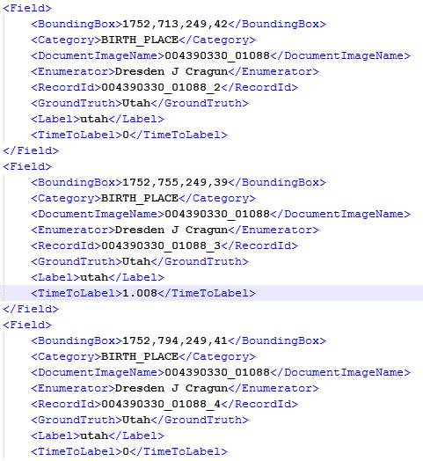
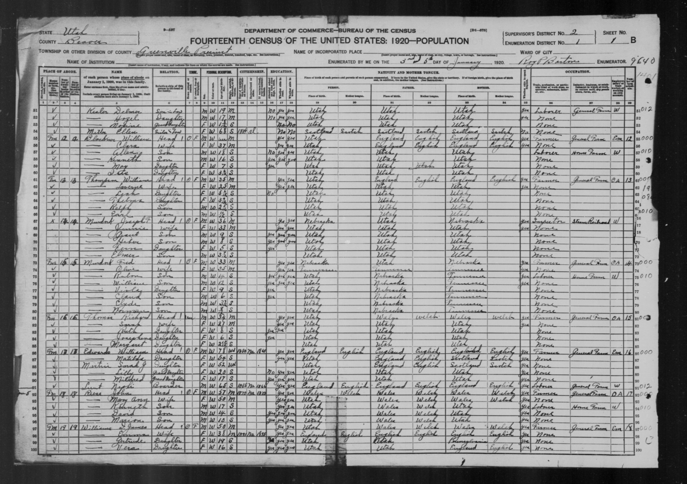
What is indexing?

Slide 3
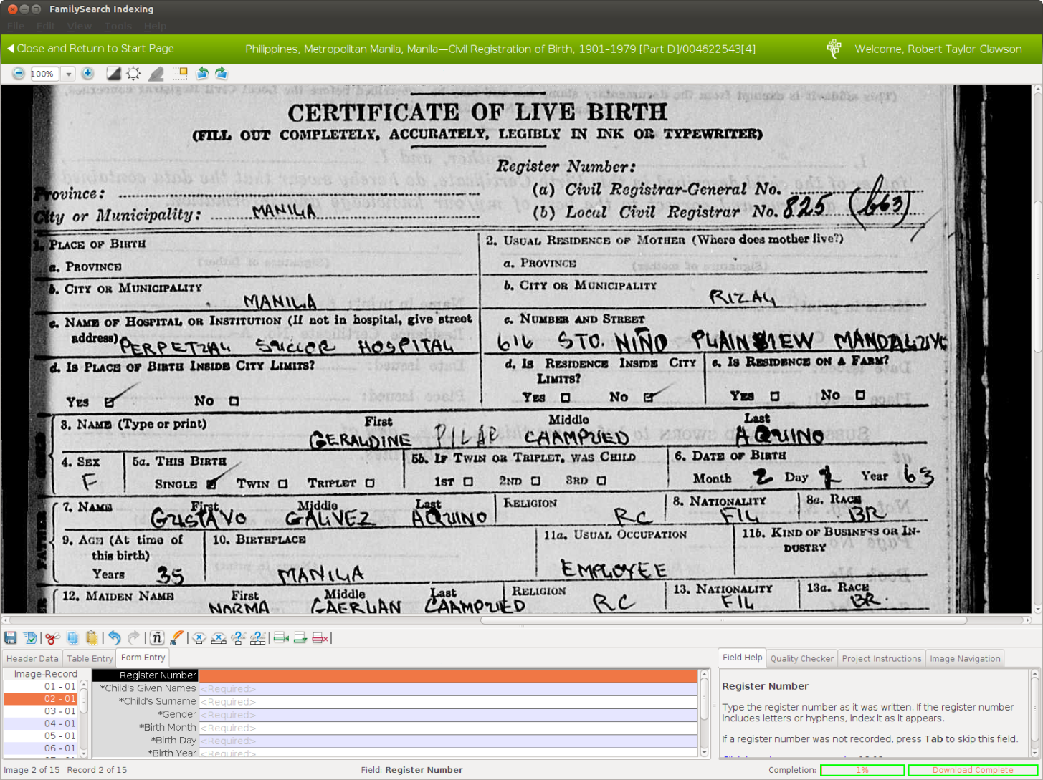
Currently…

Slide 4
Our Research
5-10 times faster
More accurate
More enjoyable
Notes:
I’m going to tell you how we got to where we are, and then
Extend an invitation for you to try it out for yourself and help us validate our claim.

Slide 5
Word Morphing
https://www.youtube.com/watch?v=eBQjHgejchA

Slide 6
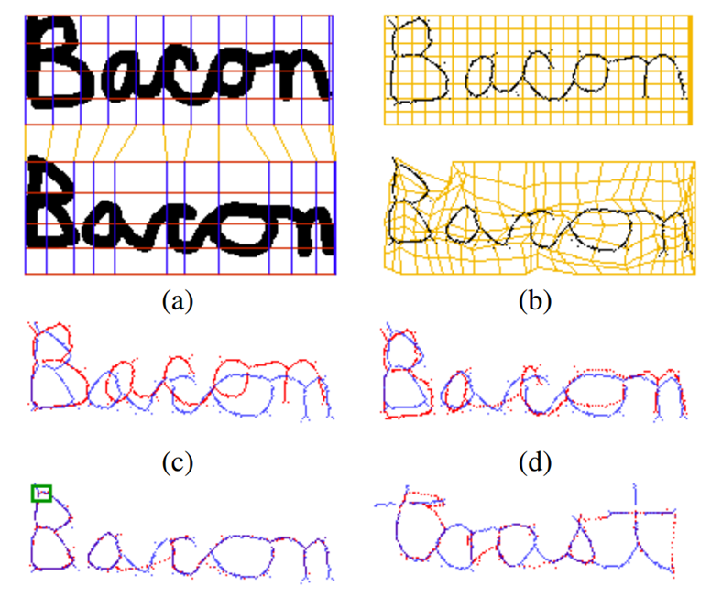
Word Morphing

Slide 7
Question
How can handwriting recognition be used to improve indexing?

Slide 8
Possible Methods
Machine Learning Approach
Split training/test set
1920 Utah Census
About 50000 fields per category
Accuracy ~80%
Error rate too high
Would require lots of corrections after the fact
Notes:
This first option we considered would be to start with a large training set, automatically label everything that the training set matched with high confidence, and hand label the rest.

Slide 9




Possible Methods
Pre-clustering
Cost Matrix for each category/document
Relationship to head of household
 | 0 | 20.2 | 15.9 | 11.4
 |  | 0 | 8.0 | 9.3
 |  |  | 0 | 3.2
 |  |  |  | 0
Notes:
This first option we considered would be to start with a large training set, automatically label everything that the training set matched with high confidence, and hand label the rest.

Slide 10
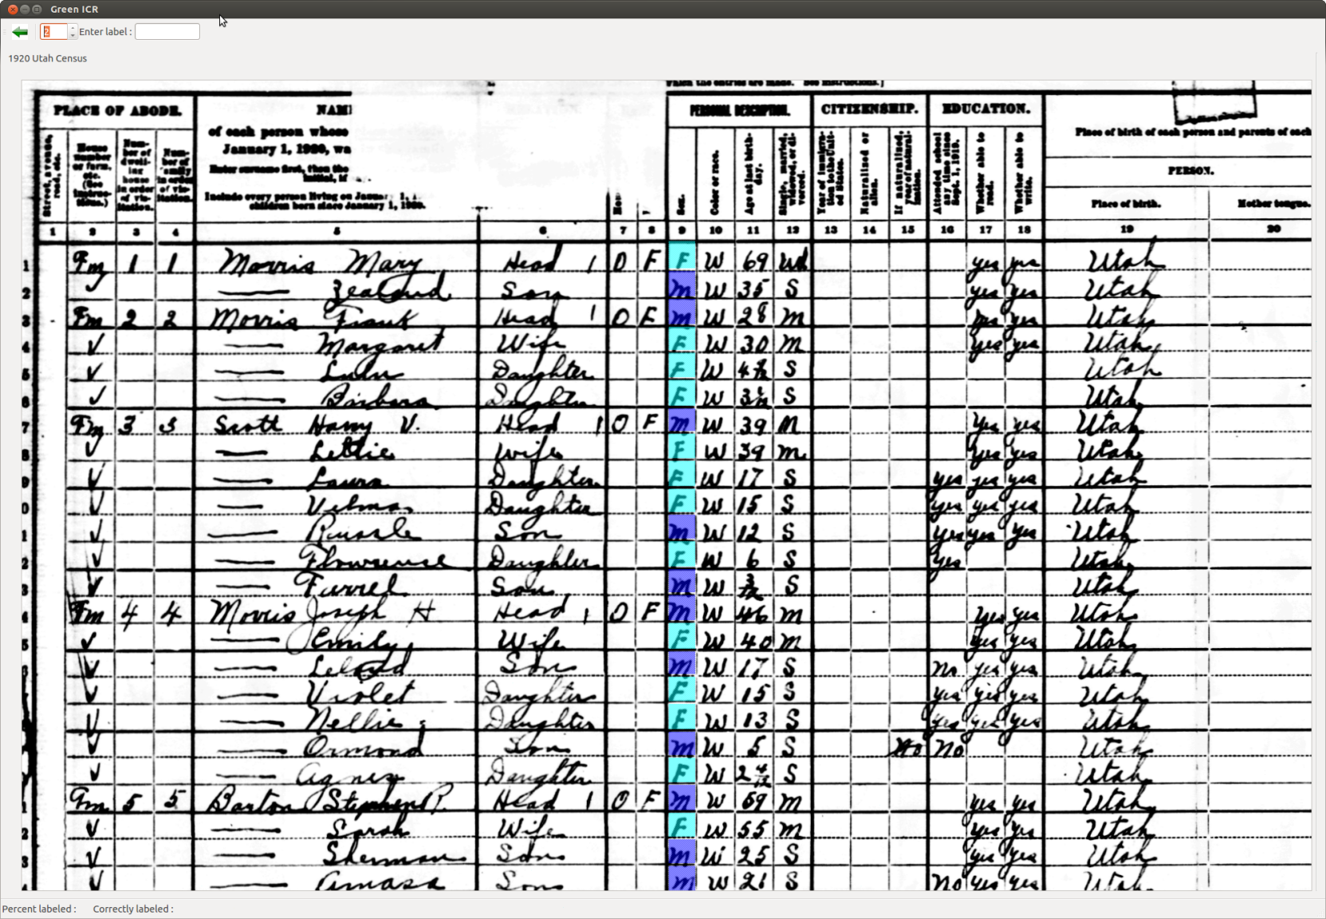
Possible Methods
Pre-clustering
Notes:
This first option we considered would be to start with a large training set, automatically label everything that the training set matched with high confidence, and hand label the rest.

Slide 11
Possible Methods
Pre-clustering
Problems
Still makes frequent errors,
Indexer has to scan up and down the page to look for mistakes
How to show clusters when there are many different words in the column?
Notes:
This first option we considered would be to start with a large training set, automatically label everything that the training set matched with high confidence, and hand label the rest.

Slide 12
Breakthrough
Interactive training: learn as you go, correct as you go
Indexer drives
Training set can start empty, quick ramp up
Still use cost matrix
Switch from per document to per enumerator
Introduce threshold
All fields that match under a threshold are labeled
Learn the threshold
Demo

Slide 13
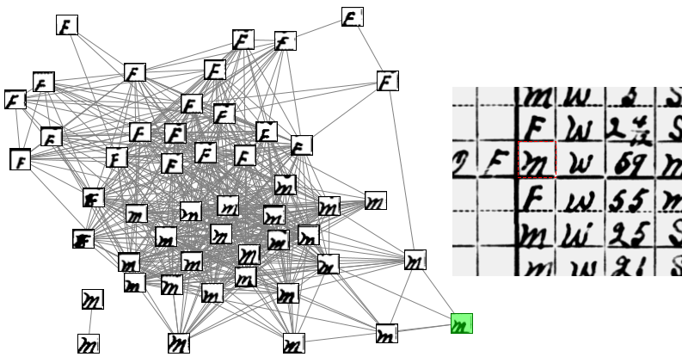
Training Set

Slide 14
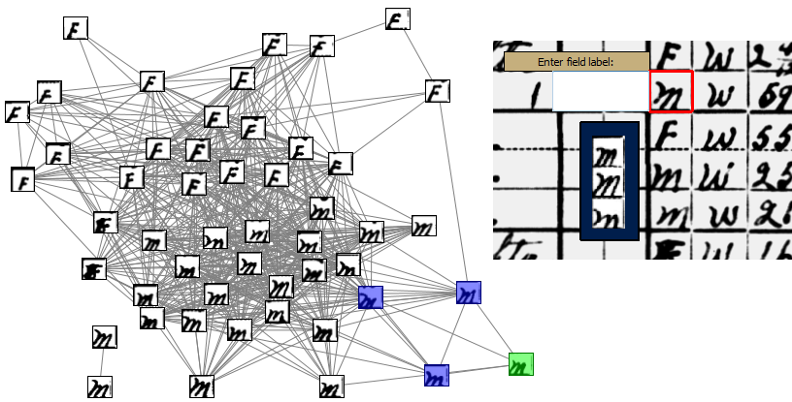
Training Set

Slide 15
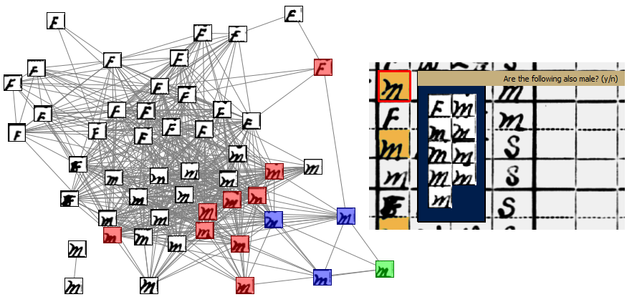
Training Set

Slide 16
You can help
We need volunteers to test Intelligent Indexing
To volunteer: email me (Robert Clawson) at:
intelligentindexing@gmail.com

